Slide 1



LYFT OFF: Uncovering Patterns of Bay-Wheel Bike share Ecosystem Classic vs. E-bikes
Emily Wu
Sean Clarke
Yiyi Yang
Yusen Tang
Olivier Larochelle

Slide 2
LYFT OFF: Uncovering Patterns of Bay-Wheel Bike share Ecosystem
Emily Wu
Sean Clarke
Yiyi Yang
Yusen Tang
Olivier Larochelle

Slide 3
PPT Structure 1. Executive summary of your findings and conclusions; 2. Description of the analytics problem; 3. Description of the data source, pre-processing steps, and exploratory results; 4. Description of the model you have selected (the choice of your model should be restricted to the one covered in class); 5. Description of the results, how the results should be interpreted 6. Implications of your results and suggestions for businesses, competitors, and markets; 7. References, including data sources, relevant articles and papers you have read

Slide 4

OUTLINE
Bay-Wheel Business Model
Datasets Creation / Preprocessing Steps
EDA
Model I
Model II
Value Proposition / Model feasibility

Slide 5
OUTLINE
Bay-Wheel Business Model
Datasets Creation / Preprocessing Steps
EDA
Model I
Model II
Value Proposition / Model feasibility

Slide 6
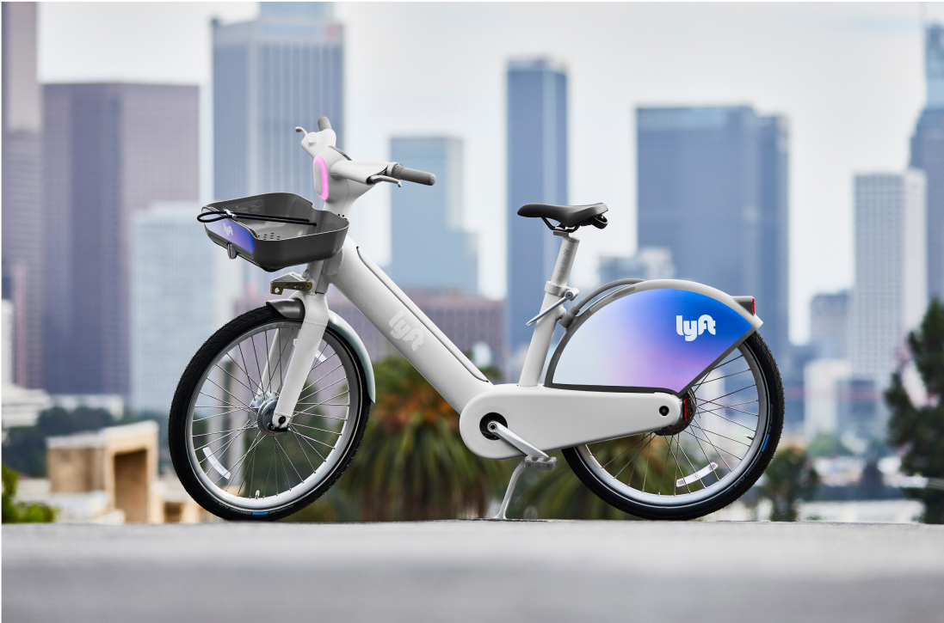
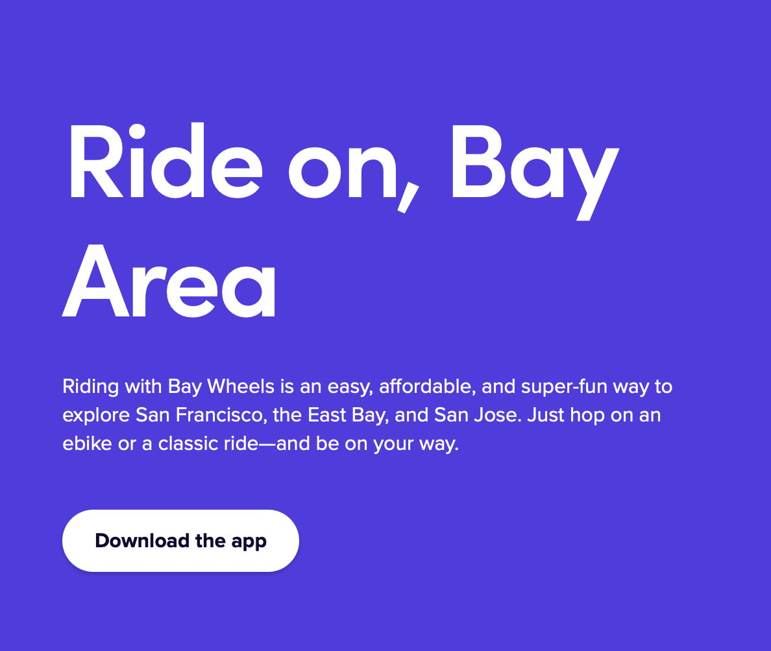
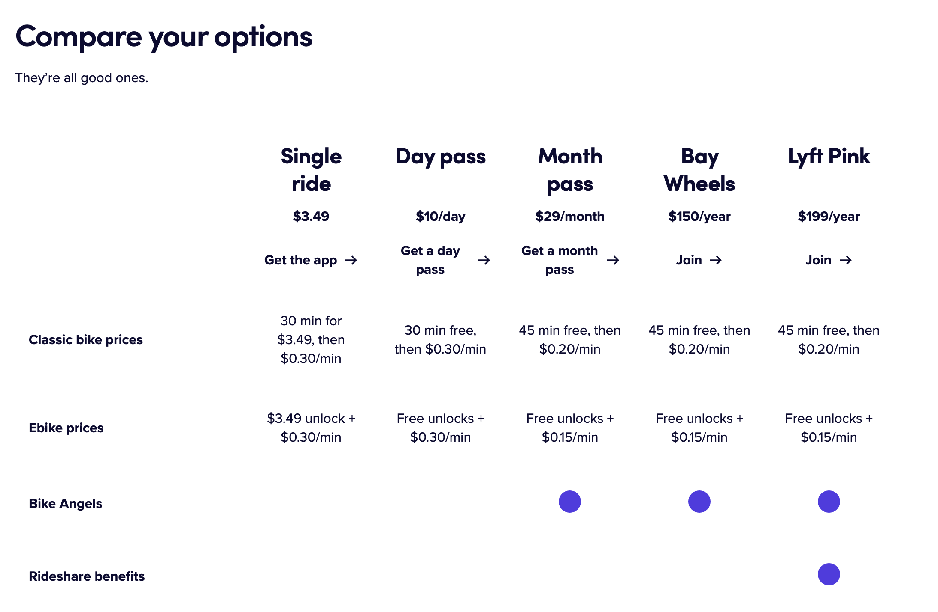
LYFT-
BAYWHEEL
BUSINESS MODEL

Slide 7
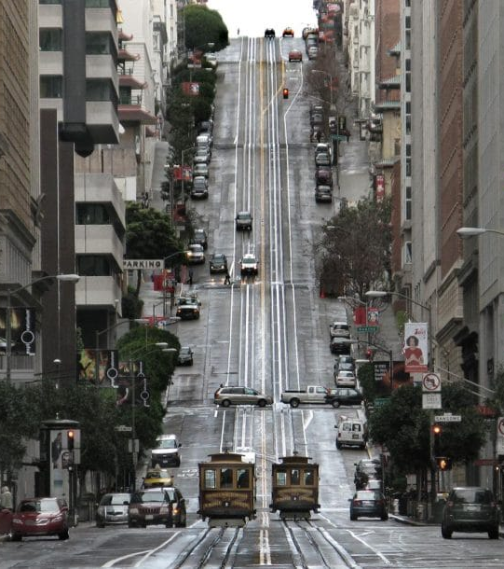
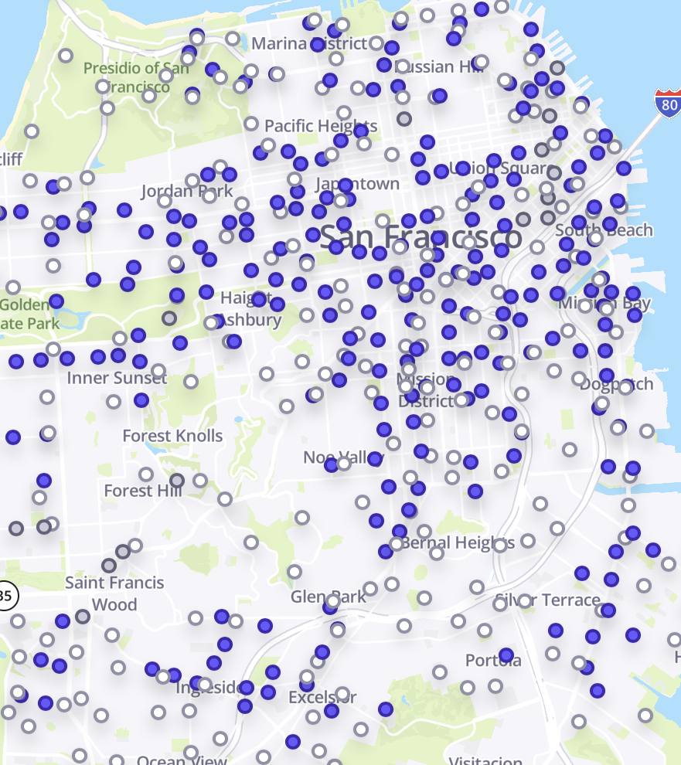
Map the Journey:
Differentiating eBike &
Classic Bike
Trip Origins and Destinations
e-Bike vs. Classic Bike:
Decision Drivers

Slide 8

Optimize bike placements aligning with real-time demand.
Refine pricing strategies for enhanced revenue generation.
Enhance membership conversion through user behavioral insights.

Slide 9
introduction
Objective & Target Audience: Uncover patterns in customer preferences between classic bikes and e-bikes within San Francisco/Bay Area’s shared bikes ecosystem(BayWheel) for Lyft.
Strategic Goals:
- Optimize bike placements aligning with real-time demand.
- Refine pricing strategies for enhanced revenue generation.
- Enhance membership conversion through user behavioral insights.
Data-Driven Insights:
- Conduct comprehensive analyses to forecast demand influenced by seasonality, weather conditions, and special days (such as holidays).
- Acquire nuanced insights into users' preferences between classic bikes and e-bikes by evaluating influential factors such as popular locations, locality-specific inclinations, and comprehensive trip metrics.
Value Proposition:
A revitalized bike-sharing service that thrives on strategic intelligence, optimizing bike placements and pricing to ensure superior user satisfaction, streamlined experiences, and sustained business growth.
Notes:
What is the business context? Who is the target audience of your project, i.e., who would you present this to if this were a “real” project? Who are the potential stakeholders? What is the aim of the project?

Slide 10
OUTLINE
Bay-Wheel Business Model
Datasets Creation / Preprocessing Steps
EDA
Model I
Model II
Value Proposition / Model feasibility

Slide 11
OUTLINE
Bay-Wheel Business Model
Datasets Creation / Preprocessing Steps
EDA
Model I
Model II
Value Proposition / Model feasibility

Slide 12


Data sources
General dataset description and potential key variables
2022-baywheels-tripdata.csv : information about individual bike trips made in the Bay Area using the Bay Wheels shared bike system for 2022 (2.6M rows)
rideable_type: Type of bike
started_at & ended_at: Start and end times of the ride.
start_station_name & end_station_name: Names of the start and end stations.
start_lat, start_lng, end_lat, & end_lng: Geographical coordinates for the start and end locations.
member_casual: Whether the rider is a member or a casual user.
They provide insights into user preferences, patterns, and behaviors, which can help optimize the bike-sharing system.
Weather.csv : daily weather data for the Bay Area.
tavg, tmin, tmax: Temperatures average, minimum and maximum.
prcp: Precipitation amount.
snow: Snowfall amount.
wdir, wspd, wpgt: Wind direction, speed and peak gust averages.
tsun: Sunshine total.
Weather conditions can influence the demand for bikes and the choice between classic and electric bikes.

Slide 13

Dataset 1: Bike trips
1
Combine monthly datasets from January 2022 to December 2022
January
February
March
December
…
2022 Lyft Trips

Slide 14

Dataset 1: Bike trips
2
Add weather attributes
2022 Lyft Trips
2022 Bay Area Weather data
Left join on date
2022 Lyft Trips

Slide 15
Dataset 1: Bike trips
3
Add Holidays
Import library “holidays”
→ Create binary attribute that takes value of 1 if the bike trip was during a Holiday; 0 otherwise
New Year's Day (January 1)
Martin Luther King Jr. Day (third Monday in January)
Presidents' Day (third Monday in February)
Memorial Day (last Monday in May)
Independence Day (July 4)
Labor Day (first Monday in September)
Columbus Day (second Monday in October)
Veterans Day (November 11)
Thanksgiving Day (fourth Thursday in November)
Christmas Day (December 25)

Slide 16
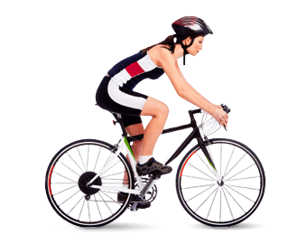
Dataset 1: Bike trips
9
8
New column:
Hour of the day during which the trip took place
(0, 1, 2 … 23)
New column:
Wind direction (North, South, East, West)
7
New column:
Distance traveled between the start and end of the bike trip
6
5
New column:
Time elapsed between the start and end of the bike trip
New column:
Day of the week during which the trip took place
(Monday, Tuesday… Sunday)
4
New column:
Month during which the trip took place
(January, February… December)

Slide 17

Dataset 1: Bike trips
There are 500+ bike stations, which is way too much to dummify.
So, we decided to use K-Means clustering to group the station in 20 different clusters
* And we got rid of the depot station and the test station
n_clusters = 20
attribute used = [latitude, longitude]
New columns:
start_cluster & end_cluster

Slide 18
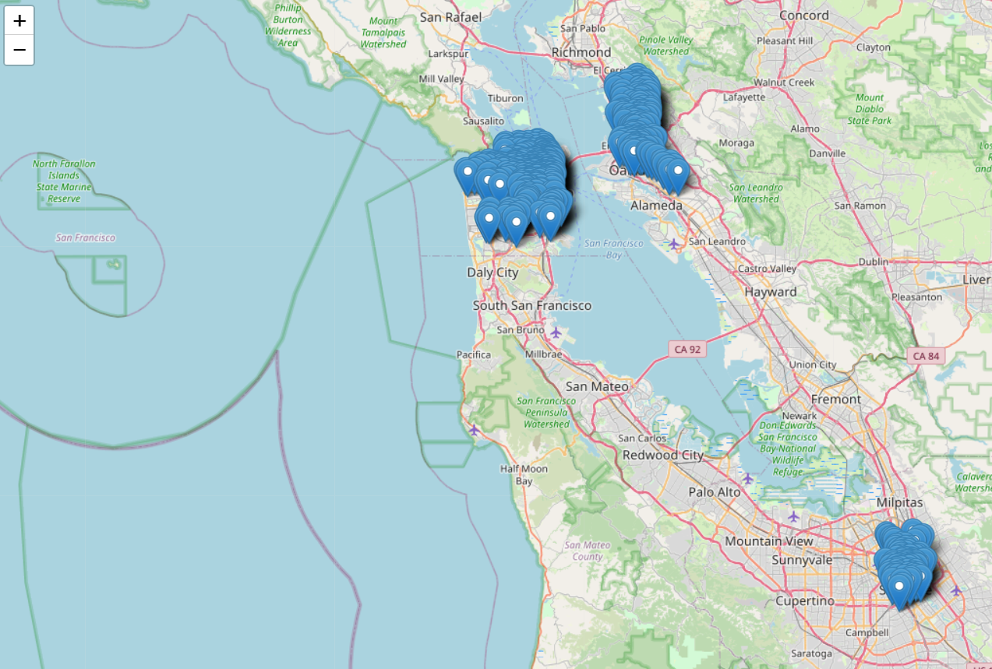
Before clustering

Slide 19
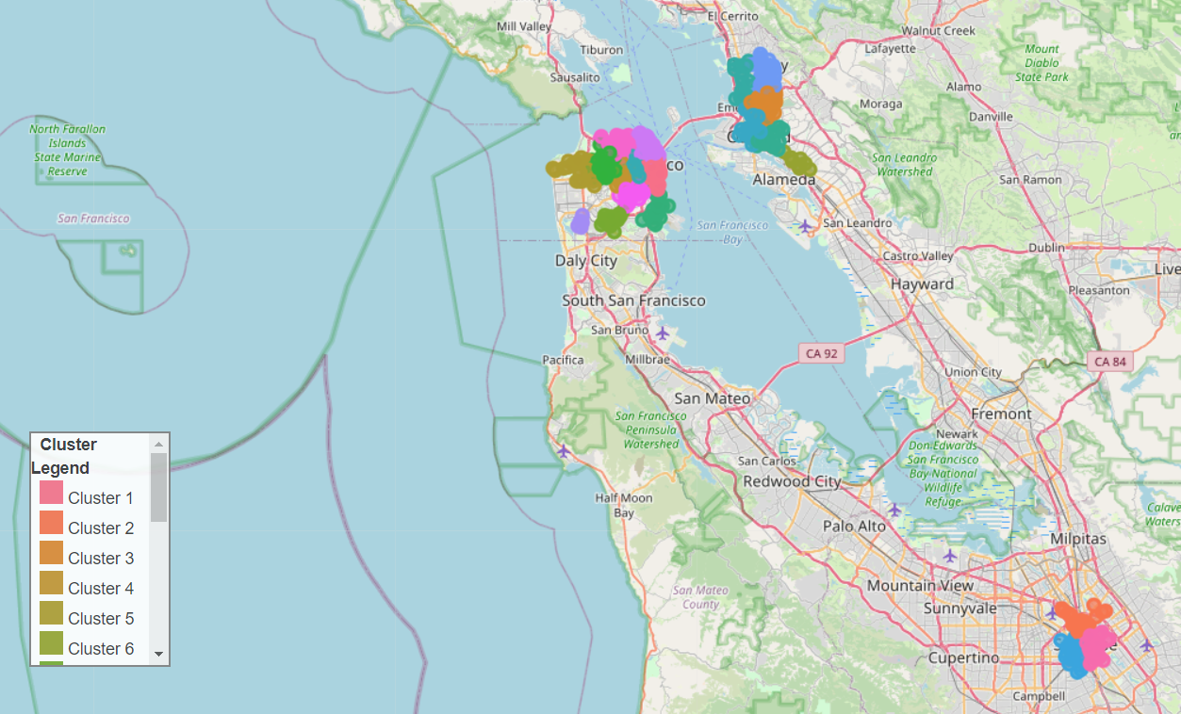
after clustering

Slide 20
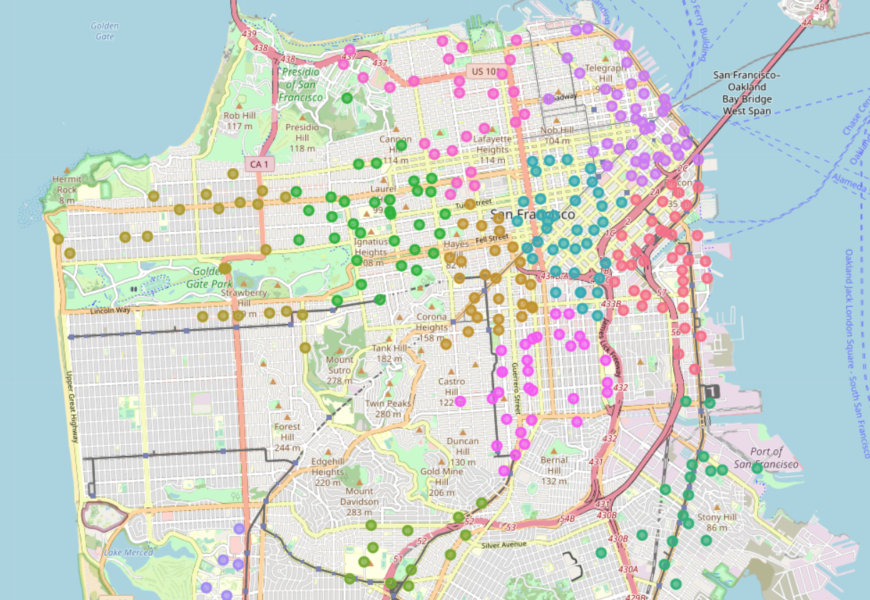

after clustering

Slide 21
Description of the Dataset
Prior knowledge or evidence from the literature:
Weather conditions have a direct impact on outdoor activities, including cycling. Factors like rain or extreme temperatures can influence the choice and frequency of bike usage.
In urban bike-sharing systems, user preferences might be influenced by trip duration, geographical challenges, and membership status.
Bike-sharing usage can vary during holidays and weekends. Leisure trips are likely to increase on holidays, while commuter trips might decrease. This shift in the purpose of bike usage can also influence the choice between classic and electric bikes.
The presence of dedicated bike lanes, connectivity to public transport, and station density can significantly influence bike-sharing usage. Areas with better infrastructure might see more frequent and longer trips.
Events, festivals, or tourist seasons can lead to spikes in bike-sharing demand. Tourists might prefer electric bikes for leisurely exploration, especially in areas with geographical challenges.

Slide 22
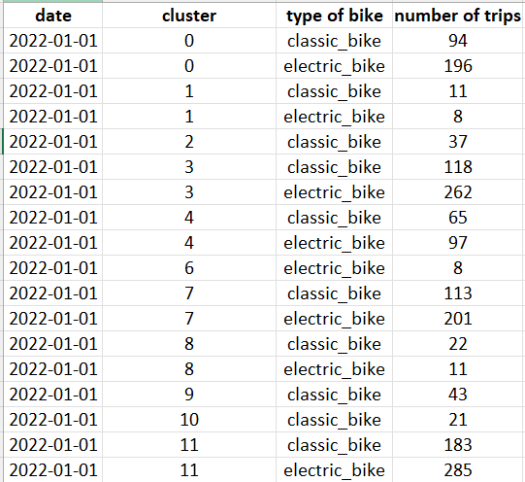
Dataset 2: Daily demand
Extract the daily demand for each type of bike for each stations cluster

Slide 23

Pre-processing on bike trips dataset
Replace docked bike with classic bike: Different terms were used while representing classic bike
Drop rows with NA values: Only contains information of undocked bikes
Drop columns with too much NA values: - snow
- wpgt
- tsun
Remove outliers
- trip time <= 1 min
- trip time >= 3 std
Drop columns that are not useful: - ride ID
- start & end station ID
- start & end station names
- start & end datetime
- start & end latitude/longitude
Standardization if needed:
All columns excluding average speed, start station cluster, end station cluster
- Method: MinMaxScaler
- Reason: contains many dummies

Slide 24
OUTLINE
Bay-Wheel Business Model
Datasets Creation / Preprocessing Steps
EDA
Model I
Model II
Value Proposition / Model feasibility

Slide 25
OUTLINE
Bay-Wheel Business Model
Datasets Creation / Preprocessing Steps
EDA
Model I
Model II
Value Proposition / Model feasibility

Slide 26
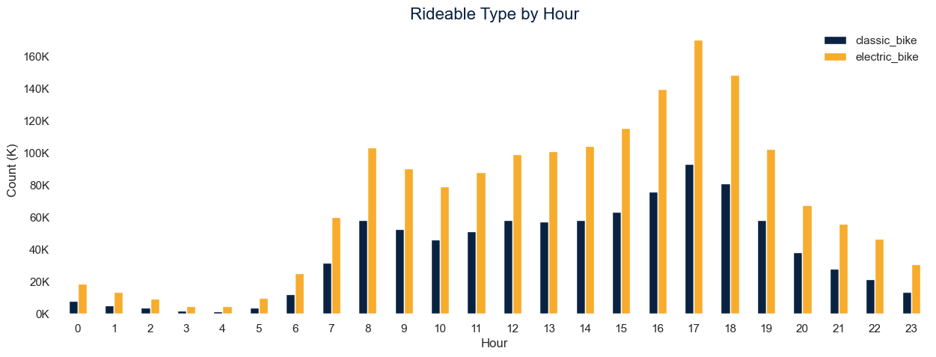
Initial Data Exploration1
7,164 daily rides
E-bikes make up 65%
On average, save you 9 minutes
Bicycles generally begin to be used more extensively from 7-8am, with usage peaking at 5pm
Notes:
E-bike avg duration is 13.56 min vs Classic which is 22.32min

Slide 27
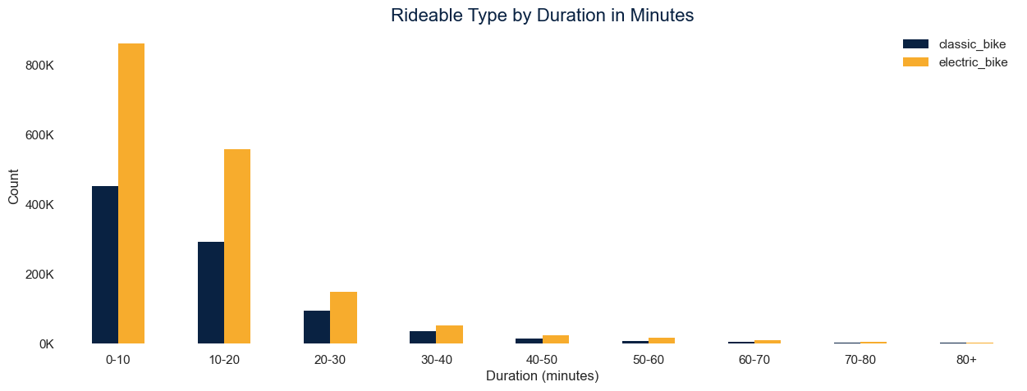
Initial Data Exploration1
Most trips are under 10 minutes. Over 30 minutes is rare!

Slide 28
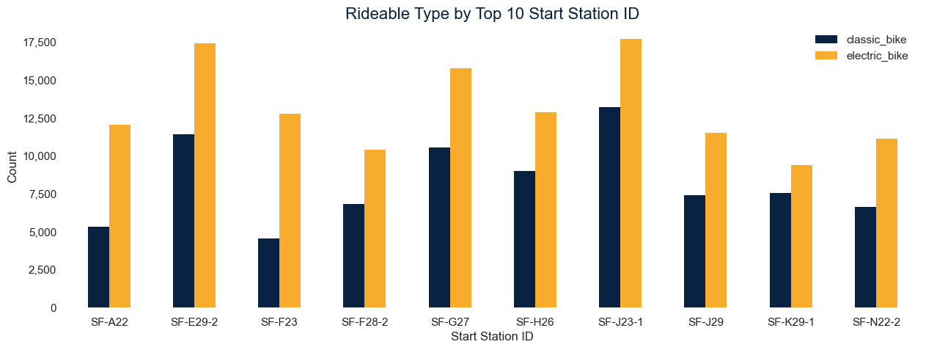
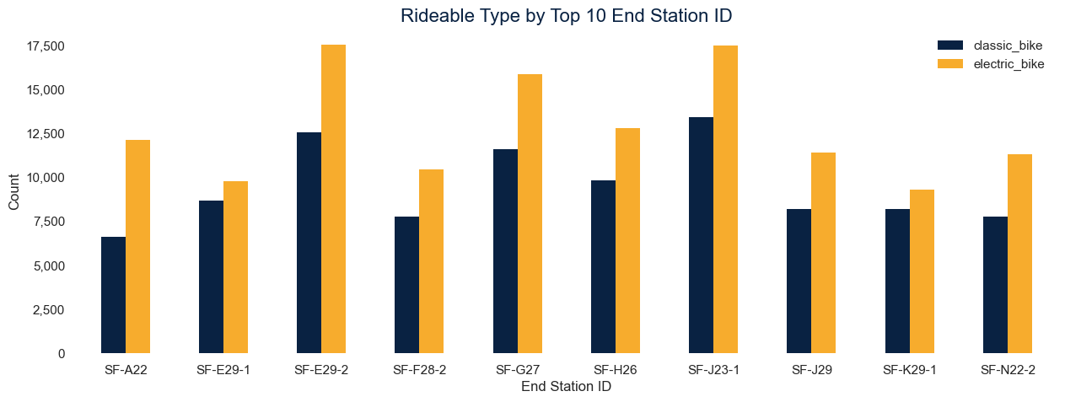
Initial Data Exploration1
Some stations are more popular than others for picking up a bike, and the same goes for dropping off a bike. This will be interesting to explore further for bike placement.

Slide 29
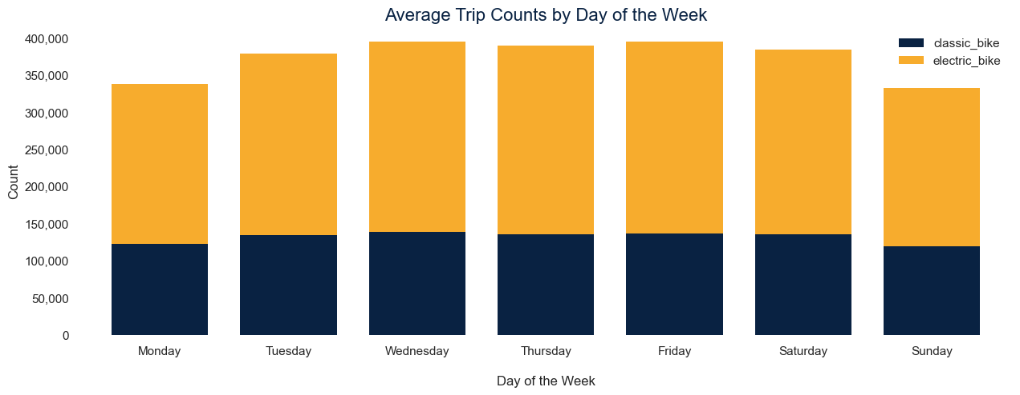
Initial Data Exploration1
Mondays and Sundays are generally less popular in terms of bike usage

Slide 30
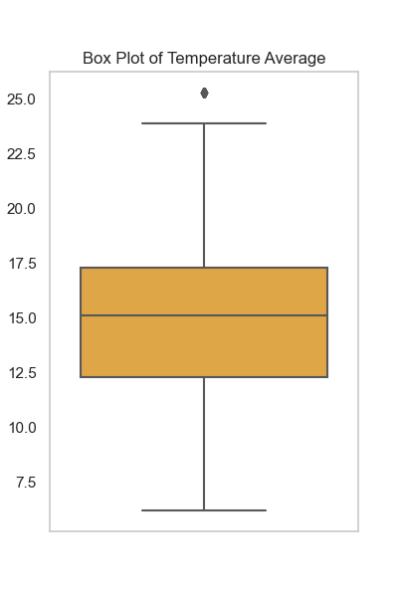
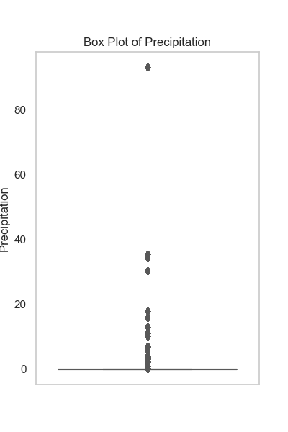
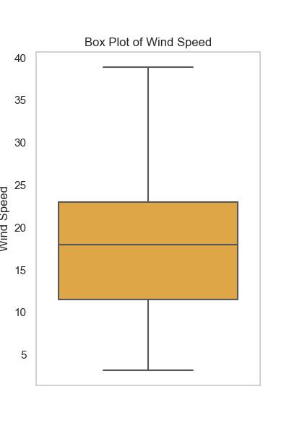
Here are some statistics represented by box plots regarding the temperature, precipitation and wind speed during the trips

Slide 31
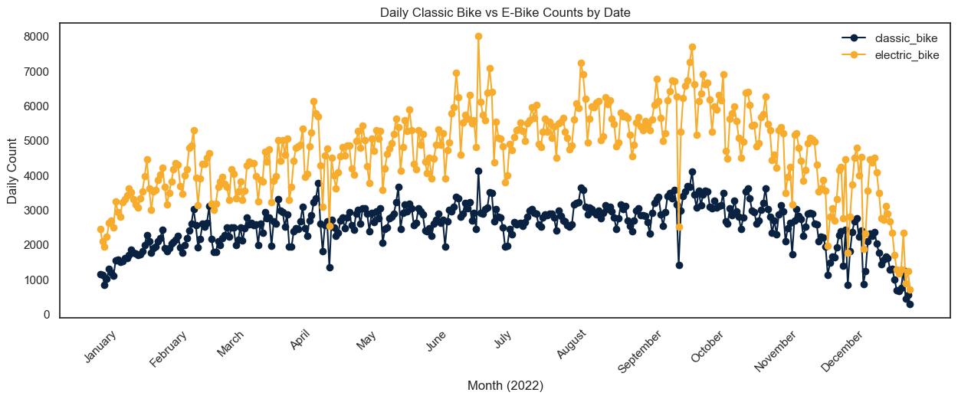

Slide 32
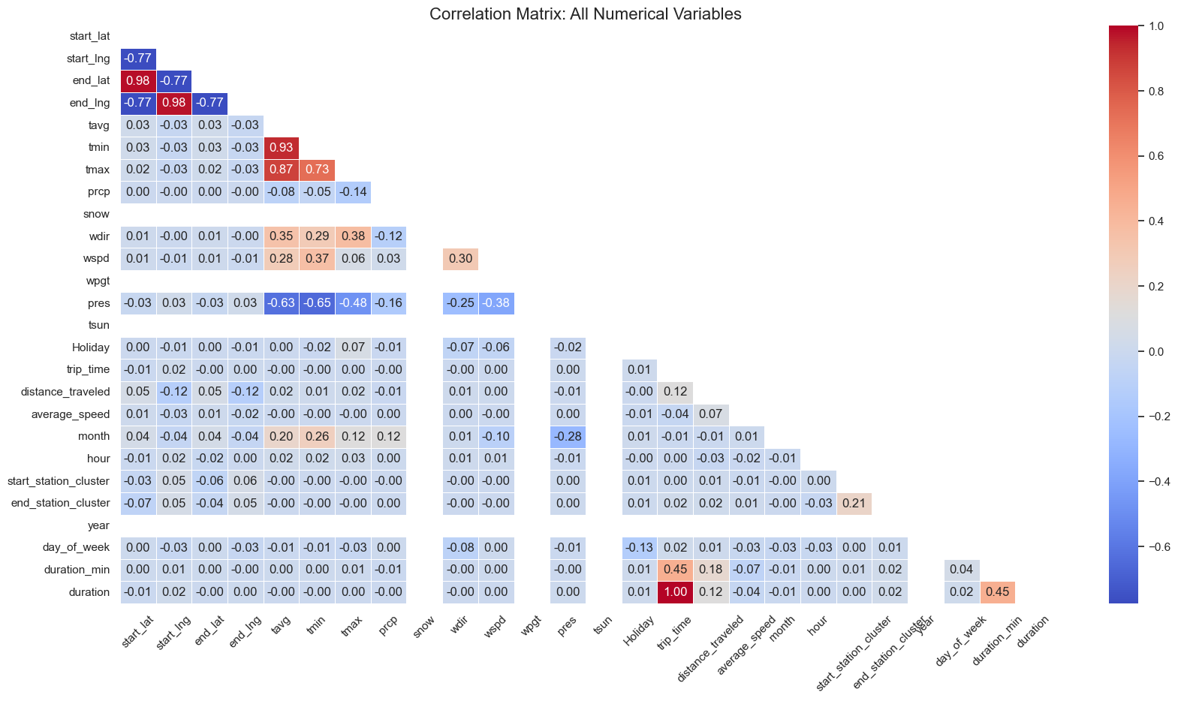

Slide 33
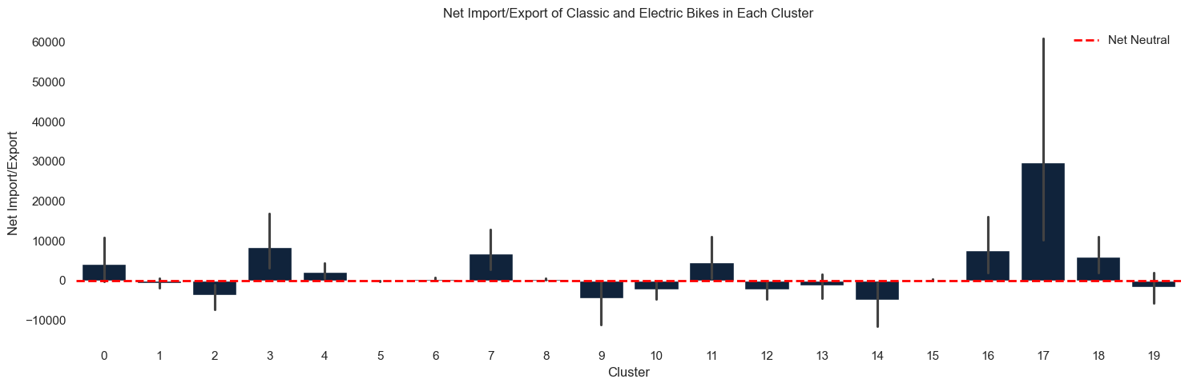

Slide 34
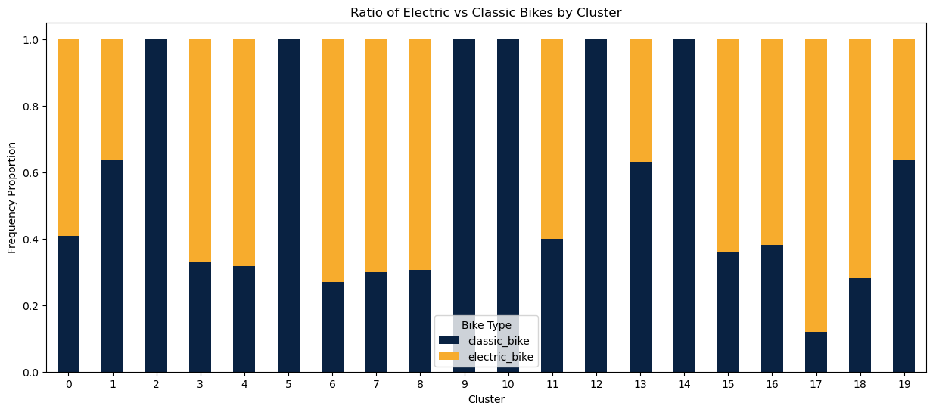
Classic bike vs e-bike Ratio

Slide 35
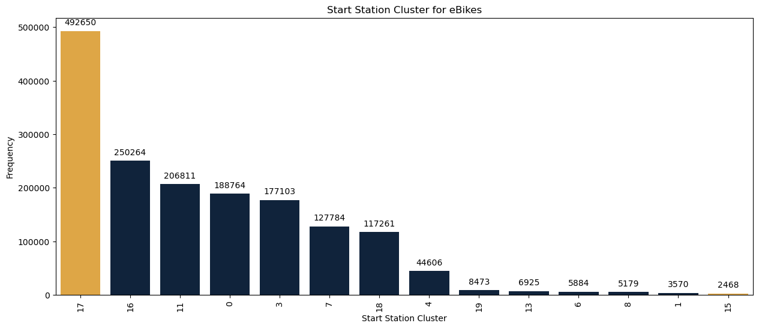
Which station has the most demand of e-bikes?

Slide 36
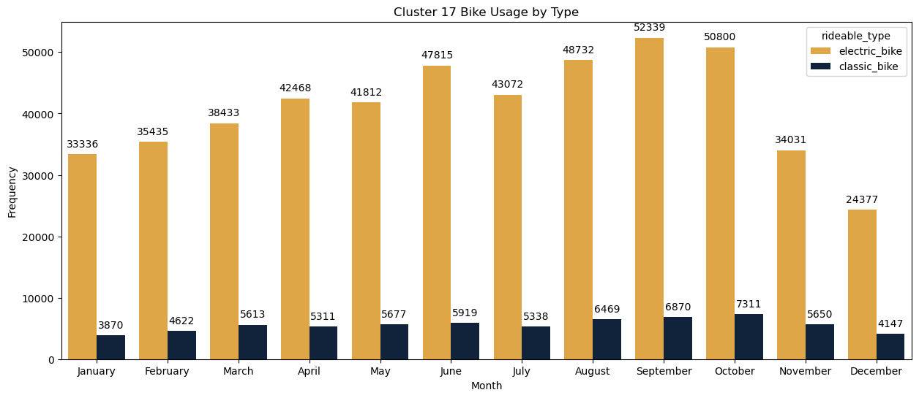
Cluster 17: e-bikes vs classic bike
88 %
E-bike
Notes:
Peak of demand happens during aug-oct

Slide 37
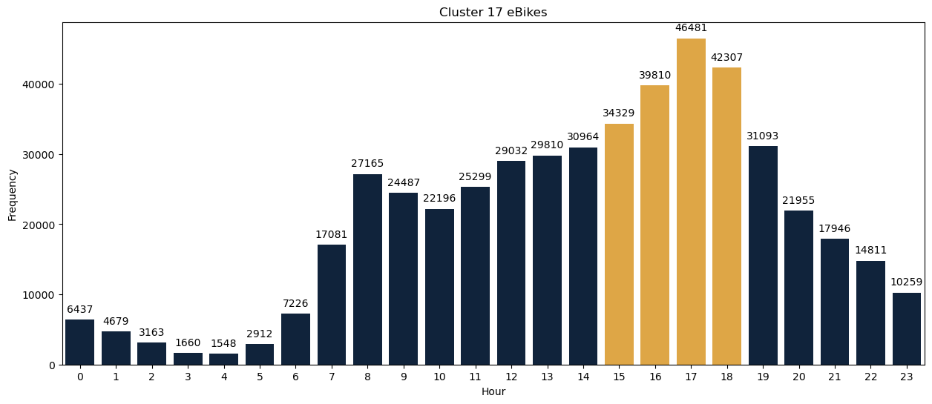
Cluster 17: Hours
03 pm
06 pm
Peak hours
Notes:
Peak happens between 3-6pm but demand increases from 7 am

Slide 38
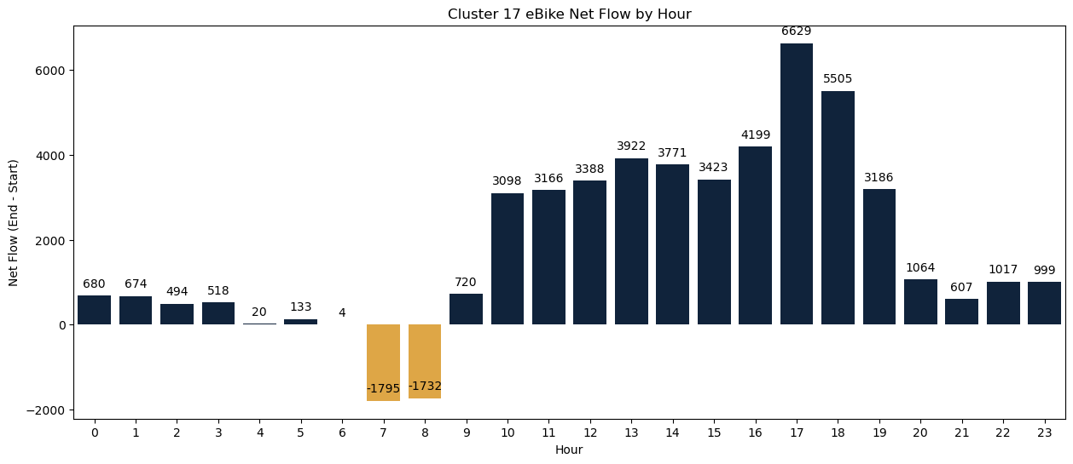
Cluster 17: e-Bike Net Flow by Hours
03 pm
06 pm
Peak hours
Notes:
Peak happens between 3-6pm but demand increases from 7 am

Slide 39
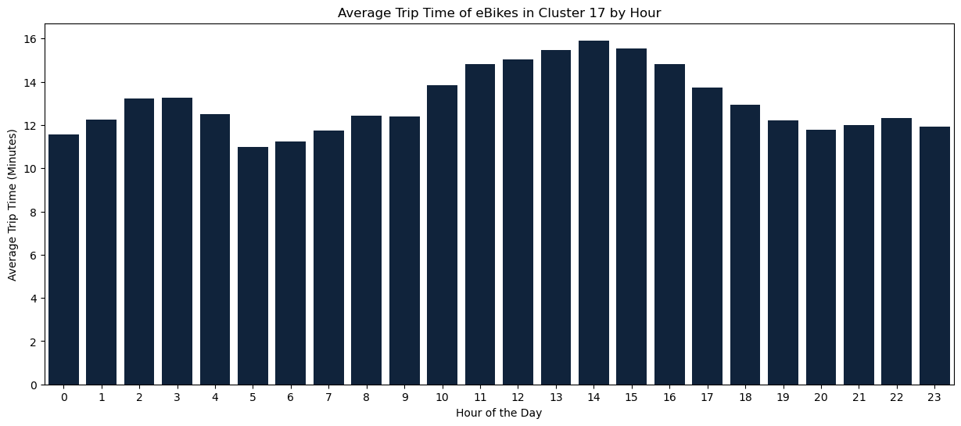
Cluster 17: Average Trip Time
03 pm
06 pm
Peak hours
Notes:
Peak happens between 3-6pm but demand increases from 7 am

Slide 40
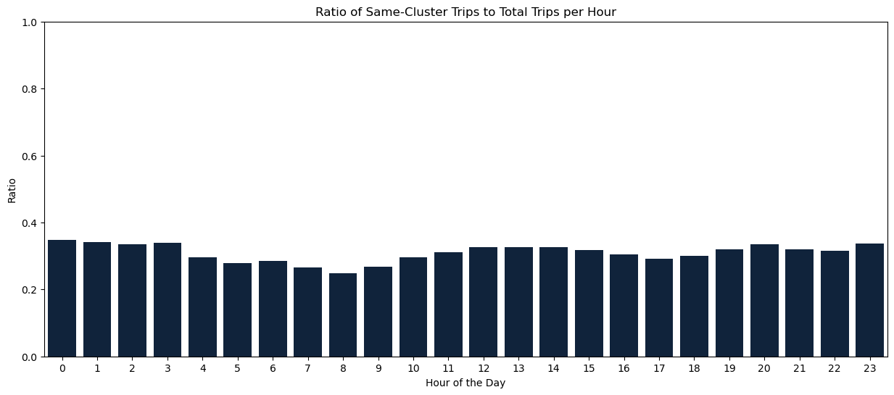
Cluster 17: ratio of within cluster trips
03 pm
06 pm
Peak hours
Notes:
Peak happens between 3-6pm but demand increases from 7 am

Slide 41
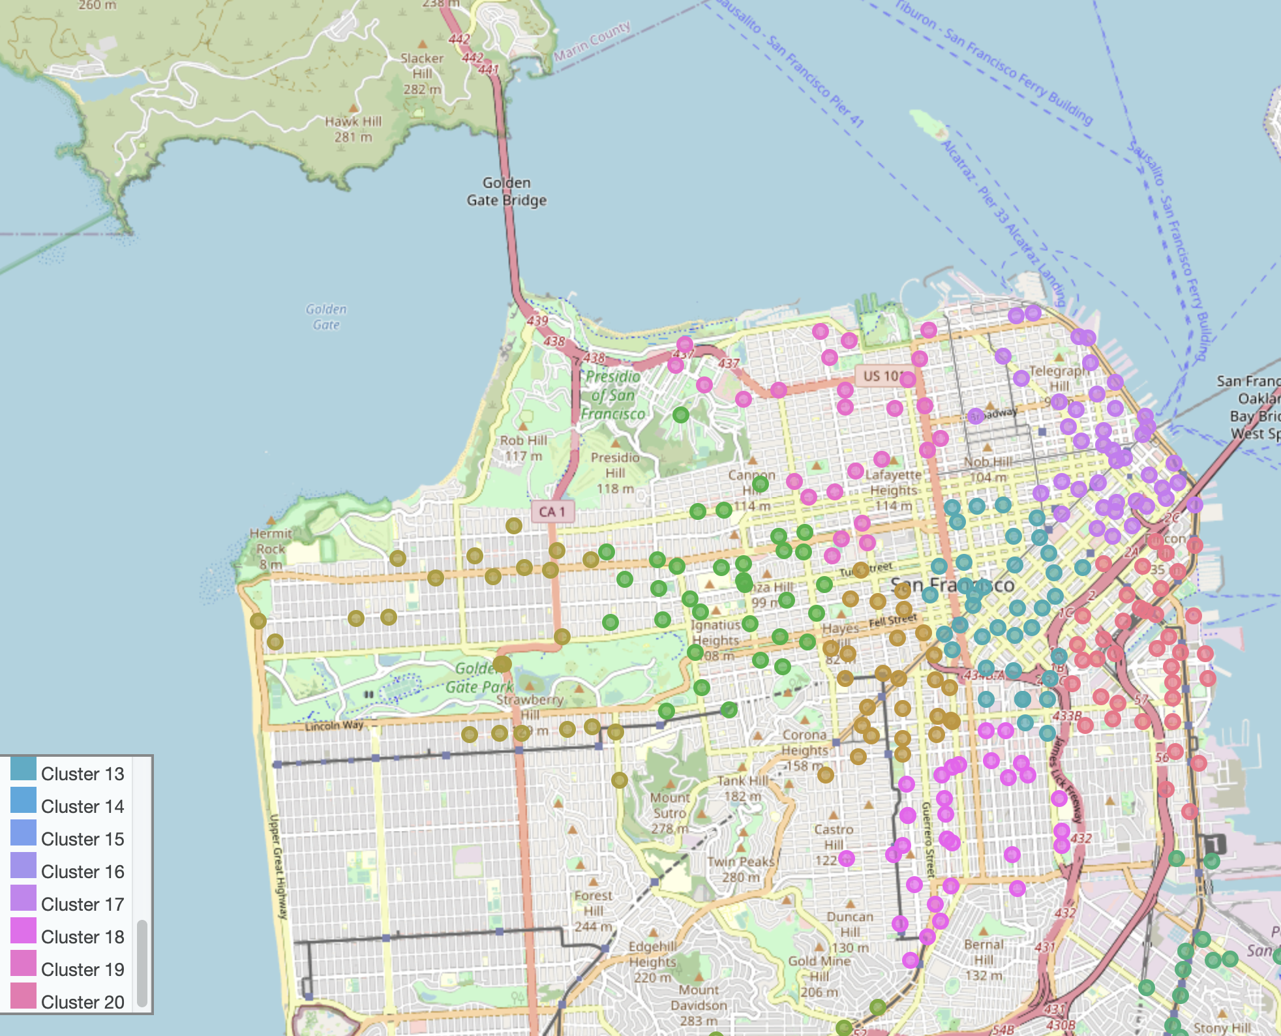
Notes:
Where is exactly cluster 17???
The map shows that cluster 17 is the purple region on the northeast

Slide 42
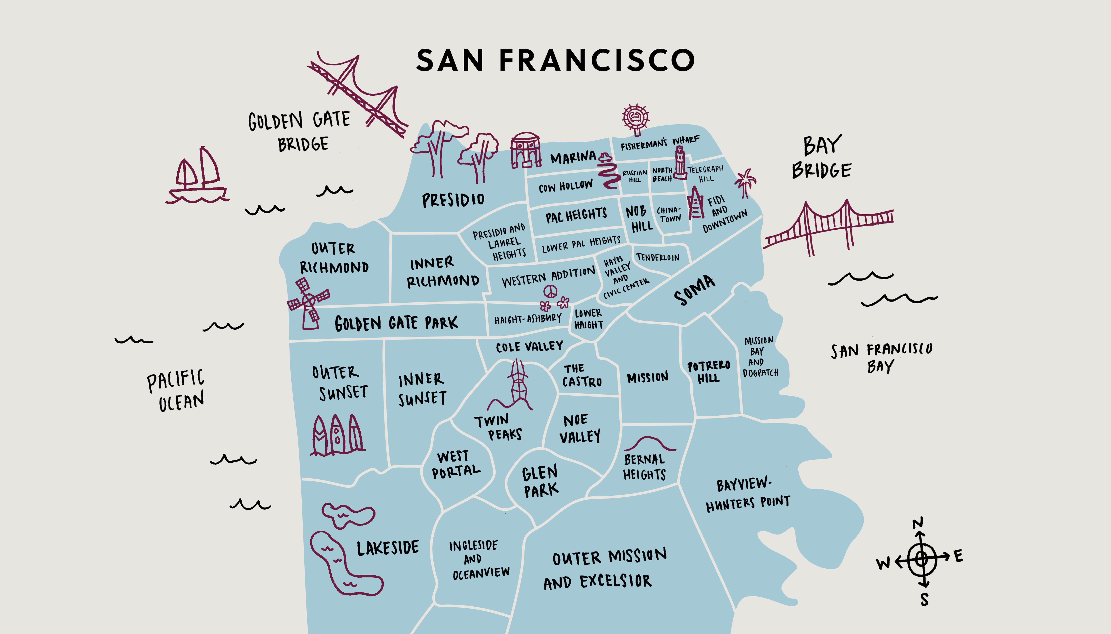
Notes:
The famous fisherman’s wharf that every tourist goes to. There’s also Coit tower that provides 360-degree views of the city an.d bay, including the Golden Gate and Bay bridges.
The china town also locates in that area. But most importantly, it’s the financial district and down town of SF!!
It totally makes sense that the peak demand happens during rush hour.

Slide 43
Which station has the least demand of e-bikes?
200X

Slide 44
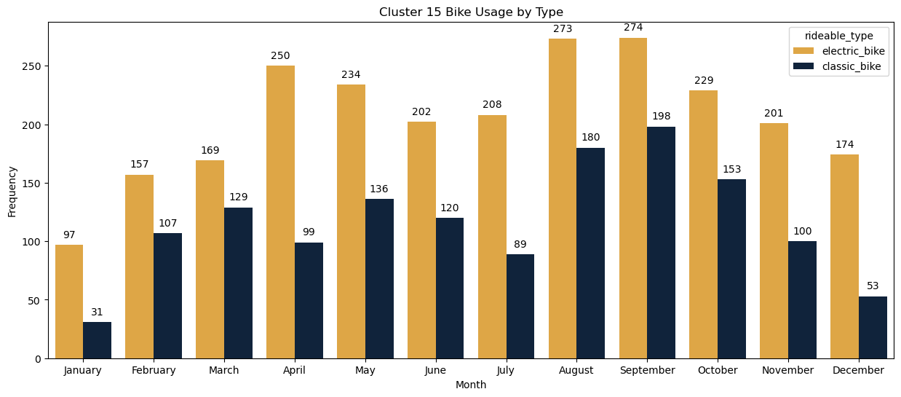
Cluster 15
64 %
E-bike
Notes:
The peak hour is also between3-6pm but the demand increases a bit later than previous cluster, at 8am.

Slide 45
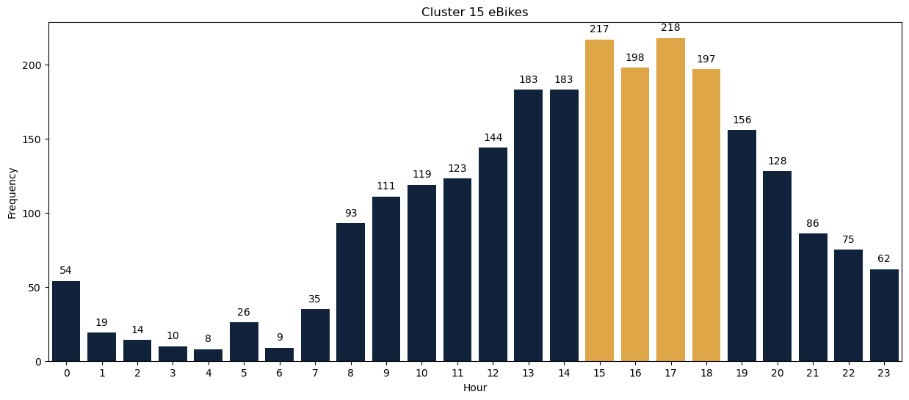
Cluster 15
03 pm
06 pm
Peak hours
Notes:
The peak hour is also between3-6pm but the demand increases a bit later than previous cluster, at 8am.

Slide 46
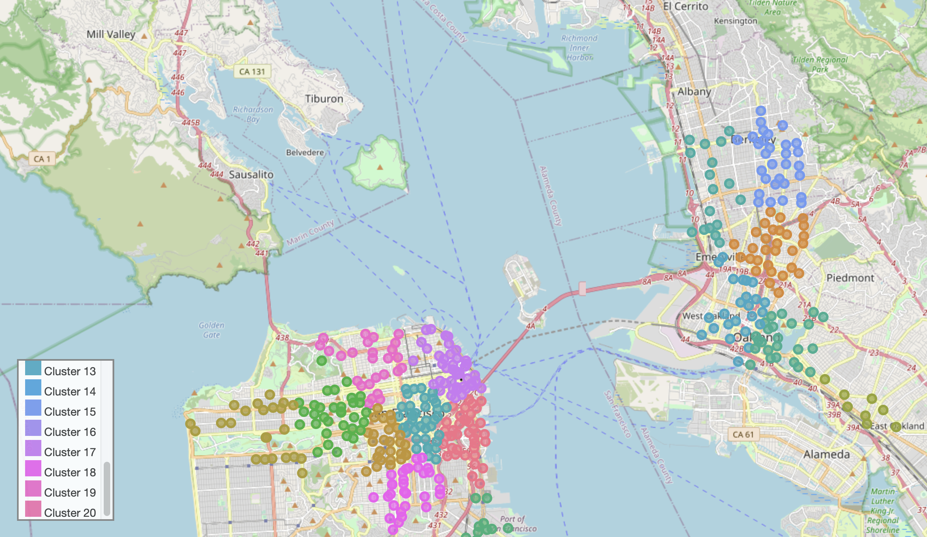
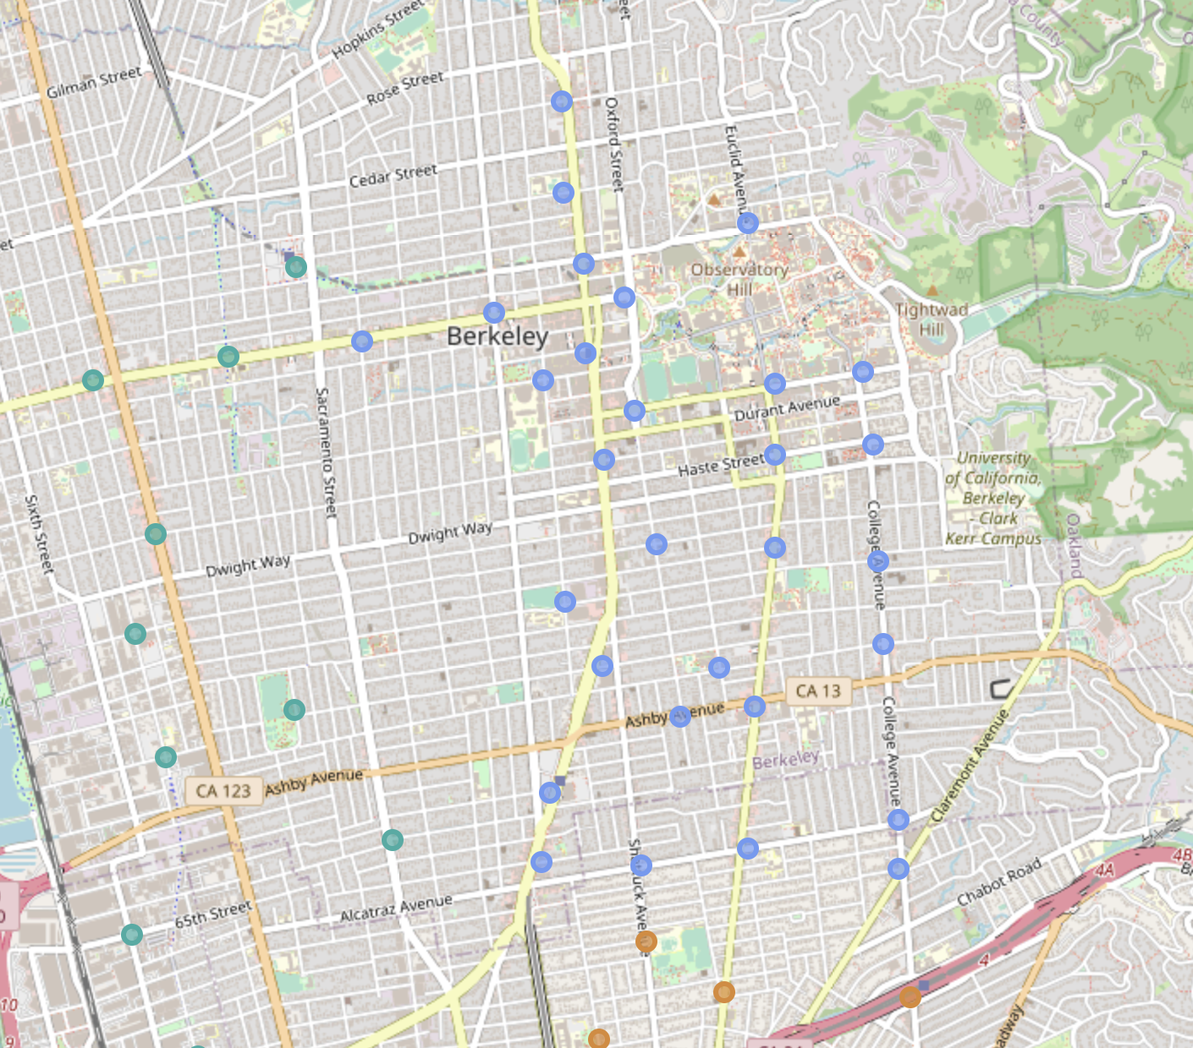

Slide 47
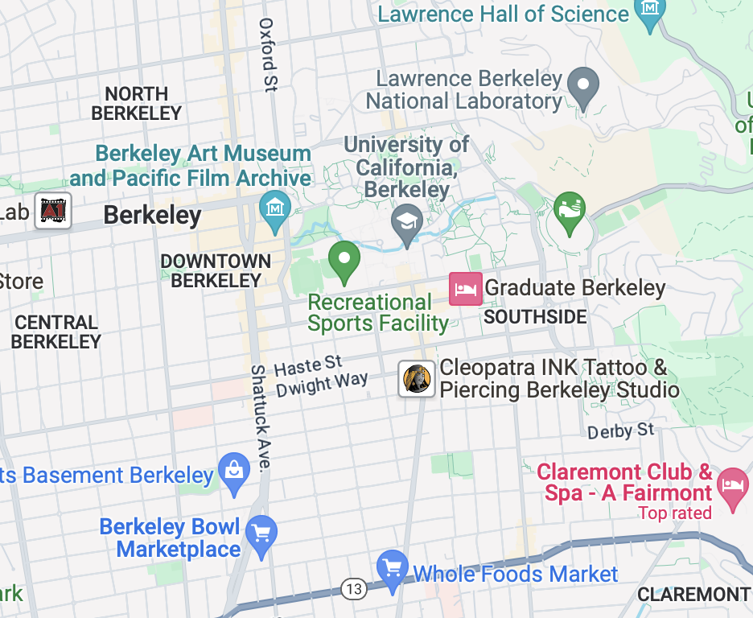
Notes:
Does anything pop up for you from the map?
Yes! UC Berkeley campus!!

Slide 48
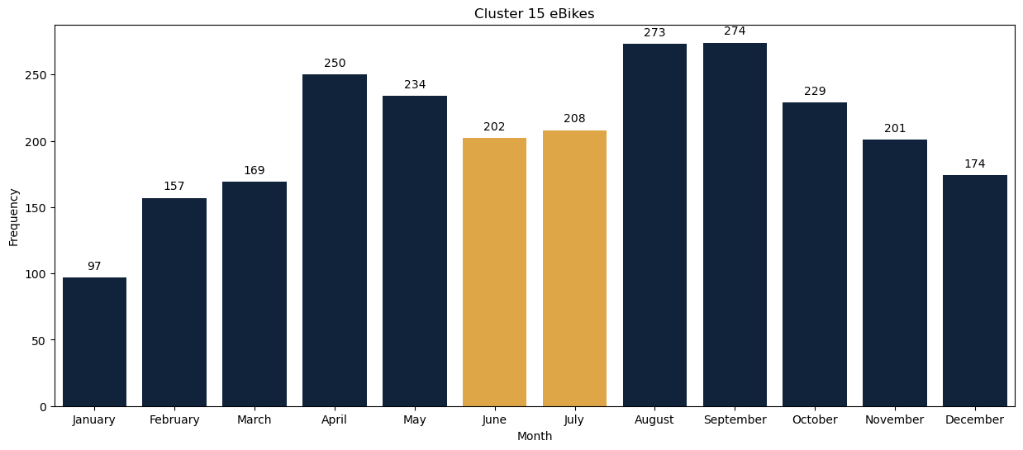
Cluster15 : Decrease of Demand in June & July
Notes:
From the trend you can see there is a sudden decrease in June and July, you might think it could be caused by the temperature
It is usual for the demand to drop during June and July!
Summer break begins in mid May

Slide 49
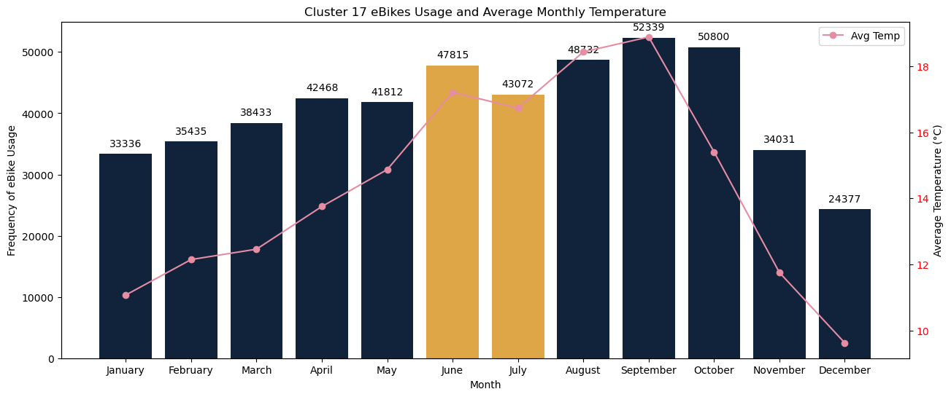
Cluster 17
Notes:
Even though temp is relatively higher in June and July, the demand doesnot drop compared to April and may

Slide 50
Cluster15: Summer Break
Mid May
Notes:
Therefore the drop in demand , is not related to temp but rather due to Summer break

Slide 51
Cluster 15: Fall term begins in Mid August
Mid Aug
Notes:
While the temperatue is quite cozy, as you can see, there is a huge gap between July and Aug!
The reason I believe is caused by the fall term rising the demand!

Slide 52
Feature Selection
Features that are Important
Start Station:
2, 3, 9, 14, 17, 18
Precipitation
If member is casual or non-casual
Features that are less Important
Wind direction
Day of the week
Average sea-level air pressure
Wind Speed

Slide 53
OUTLINE
Bay-Wheel Business Model
Datasets Creation / Preprocessing Steps
EDA
Model I
Model II
Value Proposition / Model feasibility

Slide 54
Random Forest for Bike Type Prediction
Bay-Wheel Business Model
Datasets Creation / Preprocessing Steps
EDA
Model I
Model II
Value Proposition / Model feasibility

Slide 55
Data Pre-Processing for Model I – Bike Type Prediction
1
2
3
4
Remove outliers:
Trip duration <= 1 min
Trip duration >= 3 std
Drop rows, and weather columns that as too much NA values:
Snow
Daily Sunshine Time in Minute
Peak Wind Gust
Drop columns that we don’t have information on prior to a trip:
End Station Cluster
End Station Long/Latitude
Trip Duration
Distance Travelled
Dummify categorical variables:
Start Station Cluster
Month
Day of the Week
Member/Casual Rider
Hour

Slide 56




Model Selection
Logistic Regression
Decision Tree
Random Forest
Used as a baseline for the prediction, not accurate since it assumes a linear relationship between the log odds of the outcome and the predictors.
F-1 Score: 0.70
Used as a base model for first stage hyperparameter tuning for random forest using GridSearchCV
F-1 Score: 0.72
Final model for predicting the bike type at a given cluster, hyperparameter tuning over n_estimator of [10,50,100, 200]
F-1 Score: 0.89
Parameter name | Searched Values | Best Value
max_depth | [1,2,5,10,20,…,100] | 20
max_features | [None, ‘sqrt’,’log2’] | None
min_samples_leaf | [1,2,5,10] | 10
min_samples_split | [2,5,10,20] | 2
criterion | [“gini”, “entropy”] | gini
Notes:
We started with logistic regression to run it as a baseline for the prediction, but the accuracy is very bad because the dataset does not follow the distribution that logistric regression assumes. We then used decision tree to fit the data, since we know that there are a lot of categorical variables, and it is easy to interpret. We performed hyperparameter tuning using GridSearchCV and found these to be the best parameters.
We then used random forest and got the best accuracy of 0.89 from n estimator 50.

Slide 57
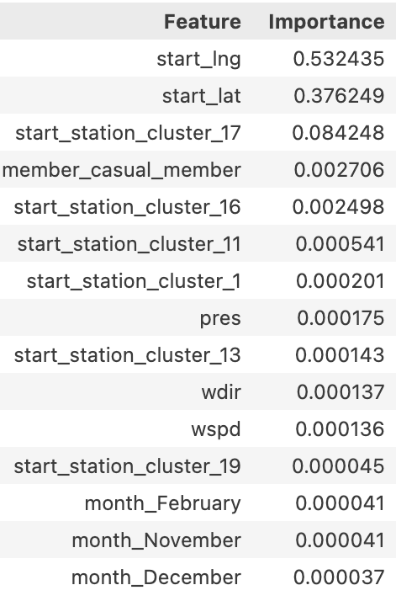
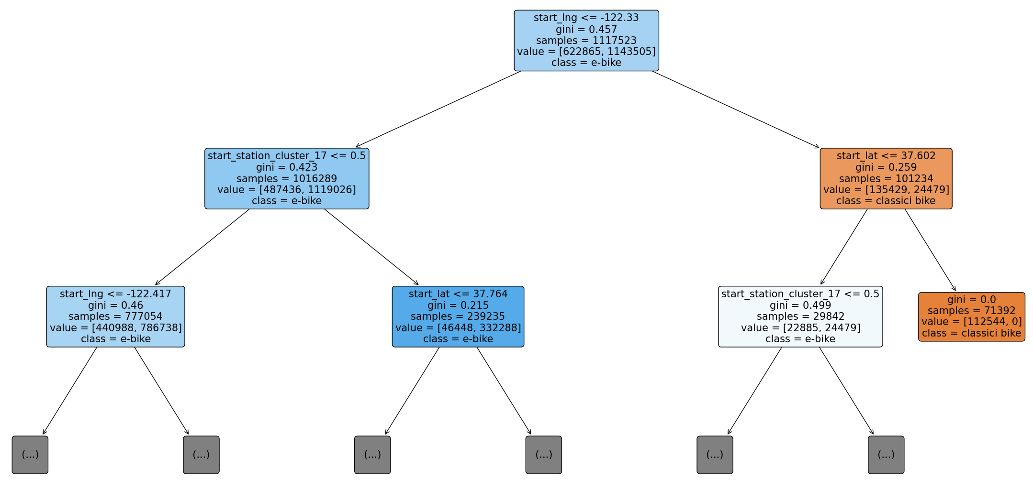
Model Result
The location of the starting station is the most important feature to decide whether a rider would take classic bike or not
Cluster 17 has the most demand among all clusters.
Notes:
The importance of a feature is calculated as the total reduction in the model's impurity that is achieved by splitting on this feature, averaged over all trees in the forest.
The feature importance is normalized so that they sum to 1. A higher value means that the feature is more important for making accurate predictions.
Although the cluster are features derived from longitude and latitude, we chose to keep them. Random forest handles multicollinearity well because it does not rely on the relationships of the features, instead it splits the data by looking at which feature reduces the impurity the most. In the presence of two highly correlated features, Random Forest will choose one of them at random for a split, but it does not affect the prediction result.

Slide 58
OUTLINE
Bay-Wheel Business Model
Datasets Creation / Preprocessing Steps
EDA
Model I
Model II
Value Proposition / Model feasibility

Slide 59
ARIMA Model for Demand Forecasting
Bay-Wheel Business Model
Datasets Creation / Preprocessing Steps
EDA
Model I
Model II
Value Proposition / Model feasibility

Slide 60
ARIMA MODEL FOR DEMAND FORCASTING

Slide 61
Summary on ARIMA(p,d,q) processes
1
2
3
AR(p) - Autoregression (AR)
This component models the correlation between a value and its lagged versions
It essentially indicates how many past data points (lags) are used to predict the current value
Higher 'p' values mean more past points are considered
I(d) - Integration (I)
Differencing involves subtracting the current value from the previous value
A stationary time series is one whose statistical properties like mean and variance are constant over time
The 'd' parameter helps in removing trends and seasonality from the series
MA(q) - Moving Average (MA)
This part represents the relationship between an observation and a residual error from a moving average model applied to lagged observations.
It accounts for the amount of 'noise' or randomness in the data
A higher 'q' value suggests a greater influence of past errors on the current observation

Slide 62
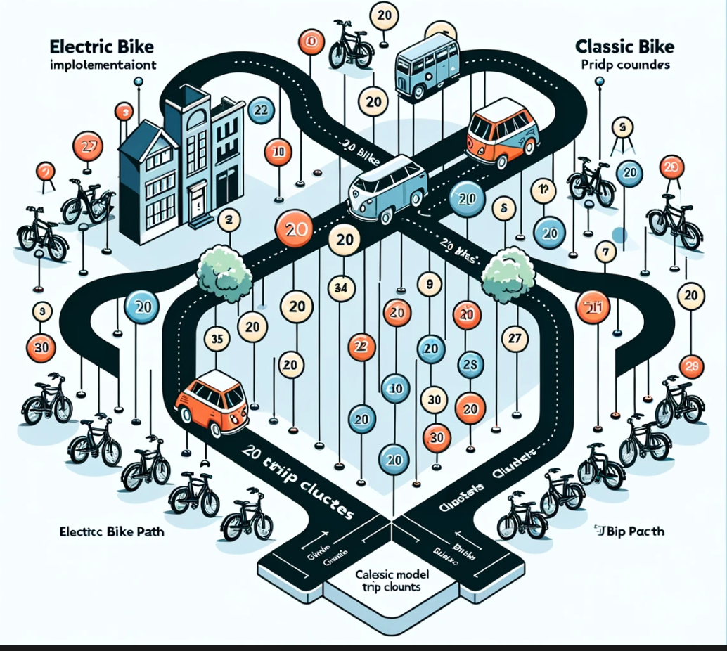
What we have?
20 location clusters
2 types of bikes
40 ARIMA models required
Function: auto_arima()

Slide 63
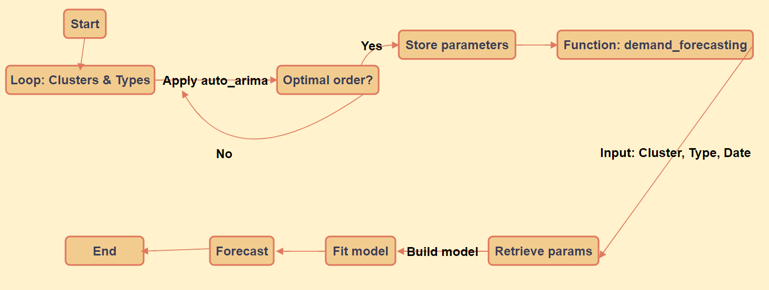
ARIMA FORCASTING FLOW CHART

Slide 64

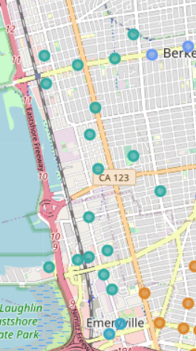
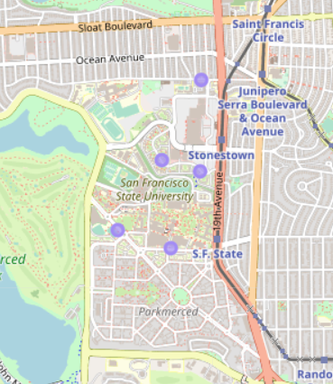
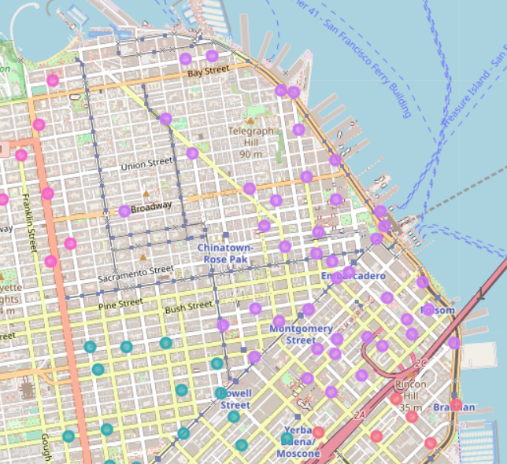
Cluster 11/16/17
Cluster 11
Classification: ebike
E-bike predicted demand: 632
E-bike actual trip count: 699
Mean Squared Error: 6737.705294238797
Mean Absolute Error: 62.50046954700911
Cluster 16
Classification: ebike
E-bike predicted demand: 708
E-bike actual trip count: 764
Mean Squared Error: 9137.626796628894
Mean Absolute Error: 72.41054060088332
Cluster 17
Classification: ebike
E-bike predicted demand: 1292
E-bike actual trip count: 1278
Mean Squared Error: 54387.85806546257
Mean Absolute Error: 165.59238716584426

Slide 65

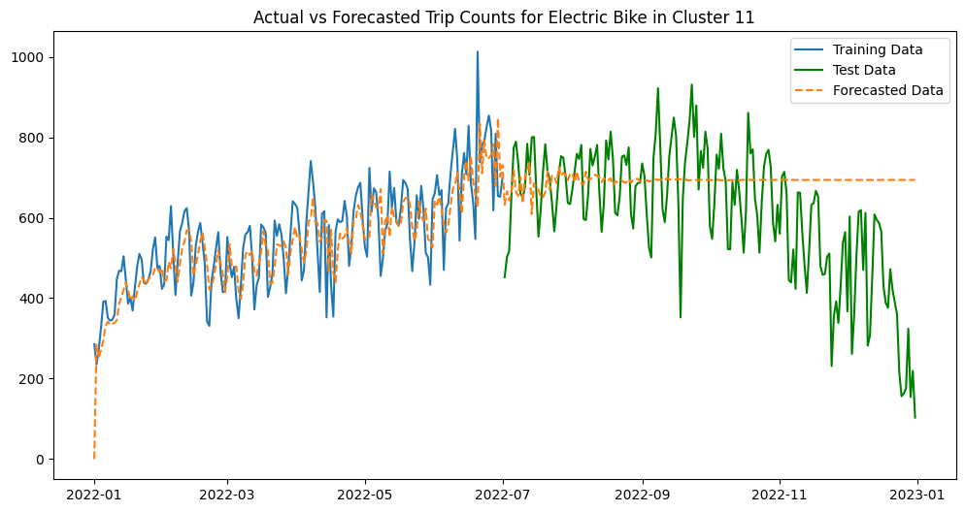
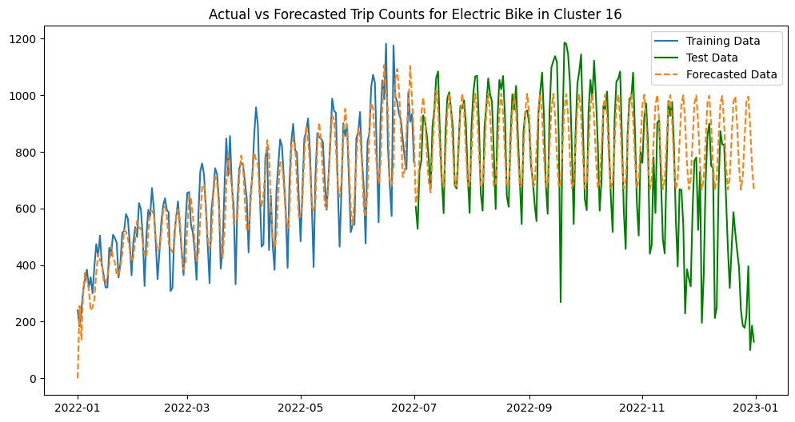
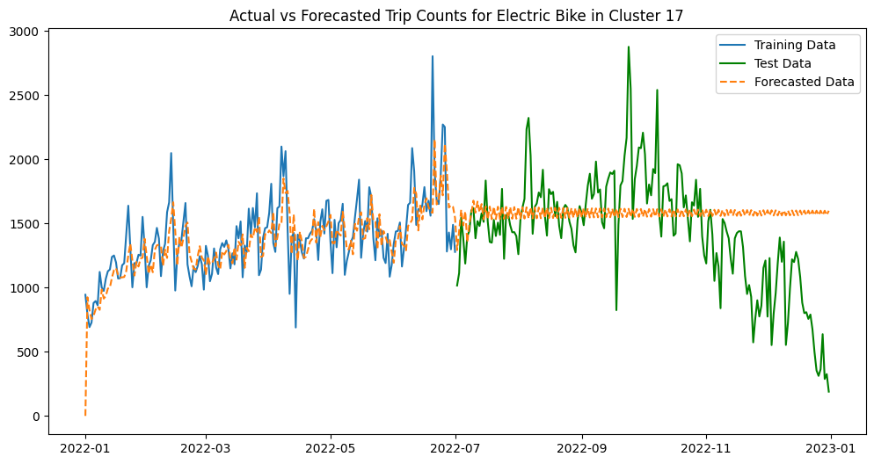
Forecasting Limitation
The Forecasting performance is bad for long time
The curve does not reflect the trend of the data

Slide 66
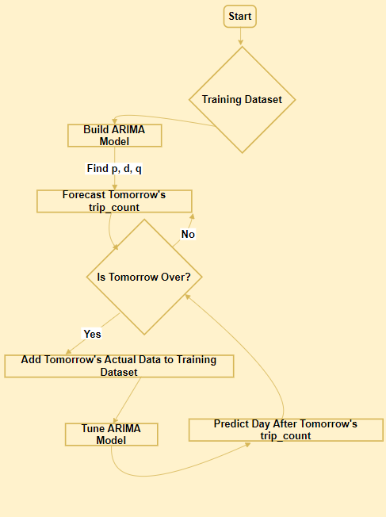
Rolling Forecasting with Updated Training Dataset

Slide 67
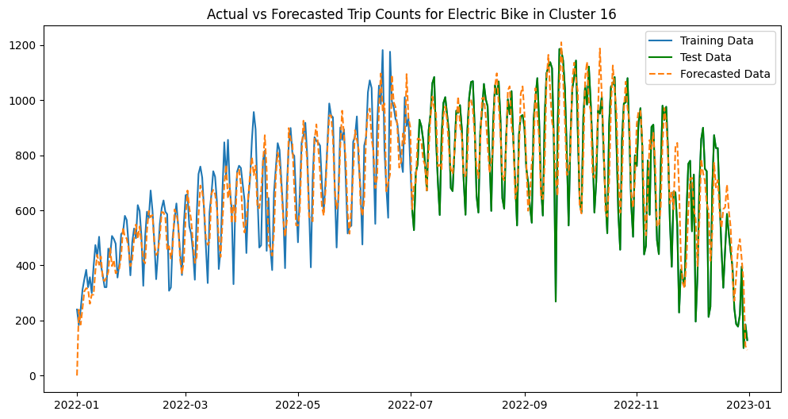
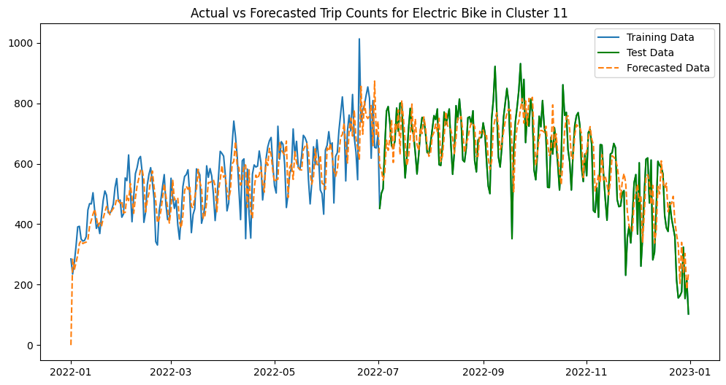

Ideally Forecasting: Create Real Business Value

Slide 68
OUTLINE
Bay-Wheel Business Model
Datasets Creation / Preprocessing Steps
EDA
Model I
Model II
Value Proposition / Model feasibility

Slide 69
OUTLINE
Bay-Wheel Business Model
Datasets Creation / Preprocessing Steps
EDA
Model I
Model II
Value Proposition / Model feasibility

Slide 70




Value Preposition
Dynamic Pricing strategy for non-member riders
Classify and predict demand station clusters
Bike placement plan for possible unmet demand in e-bikes
Dynamically adjust price of station cluster
Technology and
Data Analysis
Marketing and Strategy
Pricing
Operations
Notes:
Product Managers: Oversee product strategies and developments.
Marketing Team: Manage campaigns, promotions, and customer engagement strategies.
Pricing and Revenue Management Teams: Pricing strategy, discounts, and offers.
Operational Teams
Ensure that bikes are adequately distributed and maintained.
Assist users and address their concerns or feedback.

Slide 71

Model Feasibility
Notes:
Currently, there are many companies successfully implementing their pricing strategy based on dynamic pricing strategy. Therefore, our proposal is to use this model as the foundation to pave the way for future pricing strategy based on demand.

Slide 72




Cluster 11/16/17
Cluster 11
Classification: ebike
E-bike predicted demand: 668
Cluster 16
Classification: ebike
E-bike predicted demand: 777
Cluster 17
Classification: ebike
E-bike predicted demand: 1442

Slide 73
Reference
https://alkaline-ml.com/pmdarima/tips_and_tricks.html
https://alkaline-ml.com/pmdarima/modules/classes.html
https://www.lyft.com/bikes/bay-wheels/system-data
https://meteostat.net/en/place/us/san-francisco?s=72494&t=2018-01-01/2023-10-10

Slide 74


Slide 75
1
Bikes
You can enter a subtitle here if you need it

Slide 76
Women bike
The initiative
Join our community
Mercury is the closest planet to the Sun and the smallest one in the Solar System
Venus has a beautiful name and is the second planet from the Sun. It’s terribly hot

Slide 77
You could use three columns, why not?
Mercury
Mercury is the smallest planet of them all
Venus
Venus has a beautiful name, but it’s very hot
Saturn
Yes, this is the ringed planet. It’s a gas giant

Slide 78

A picture always reinforces the concept
Images reveal large amounts of data, so remember: use an image instead of long texts

Slide 79

A picture is worth a thousand words

Slide 80
Awesome words
Because key words are great for catching your audience’s attention

Slide 81

The number of bicyclists is growing rapidly
35%
65%
Non bicyclists
Despite being red, Mars is a cold place
New national users
Mercury is the closest planet to the Sun
If you want to modify this graph, click on it, follow the link, change the data and replace it

Slide 82
The growth of bike commuting
Non-bicycle communities: 31%
Venus has a beautiful name
All of United States: 62%
Despite being red, Mars is a cold place
Bicycle communities: 105%
Jupiter is the biggest planet

Slide 83
How do we do that?
Board
Staff
Operations
Mercury is the closest planet to the Sun
Venus has a beautiful name, but it’s very hot
Despite being red, Mars is a cold place
Communications
Research
Publications
Yes, this is the ringed planet. It’s a gas giant
It’s the biggest planet in the Solar System
Neptune is the farthest planet from the Sun

Slide 84
Equity, diversity & inclusion
Diversity
Despite being red, Mars is cold
Equity
Venus has a beautiful name
Inclusion
Jupiter is the biggest planet

Slide 85
This is a table
 | Bike type | Km | Speed
Mercury | Road | 38 | 0.38
Mars | Mountain | 53 | 0.38
Saturn | Hybrid | 94 | 1.16

Slide 86
Bicycle friendly states
State ranking position
Mercury is the closest planet to the Sun and the smallest one in the Solar System
1-10
31-40
11-20
41-50
21-30

Slide 87
A timeline always works fine
1
2
3
4
It’s composed mostly of gases
Earth is the planet we live on
Despite being red, Mars is a cold place
Venus has a beautiful name

Slide 88
4,498,300,000
Big numbers catch your audience’s attention

Slide 89
333,000.00
24h 37m 23s
386,000 km
Bicycle friendly communities
Hours by bicycle per person
The total distance by bicycle

Slide 90
Our team
John James
Jane Doe
Here you can talk a bit about this person
Here you can talk a bit about this person
Jennifer Patterson
Jack John
Here you can talk a bit about this person
Here you can talk a bit about this person

Slide 91

Sneak peek
You can replace the image on the screen with your own work. Just delete this one, add yours and center it properly

Slide 92

Sneak peek
You can replace the image on the screen with your own work. Just delete this one, add yours and center it properly

Slide 93

Sneak peek
You can replace the image on the screen with your own work. Just delete this one, add yours and center it properly

Slide 94
Bike week
Mercury is the closest planet to the Sun and the smallest one in the Solar System

Slide 95
Recommendations
Join our community
Prepare your bicycle with time
Choose your best route to ride
Mercury is the closest planet to the Sun
Venus has a beautiful name, but it’s very hot
Despite being red, Mars is a cold place

Slide 96
How to prepare your bike
1
2
Saddle area
Mercury is the closest planet to the Sun
Wheels
Venus has a beautiful name, but it’s very hot

Slide 97

Multimedia
Insert your multimedia content here

Slide 98
Our best experiences
66 Route
Mercury is the closest planet to the Sun
East Coast
Venus has a beautiful name, but it’s very hot

Slide 99
Why being part of our community
Exclusive chat
Dedicated groups
Customized routes
Monthly bicycle checking
National community
Bike accessories
Special discounts

Slide 100
National bicycle communities
New York
San Francisco
Los Angeles
Mercury is the closest planet to the Sun
Venus has a beautiful name, but it’s very hot
Despite being red, Mars is a cold place
Chicago
Las Vegas
Yes, this is the ringed planet. It’s a gas giant
It’s the biggest planet in the Solar System

Slide 101
Thanks
Do you have any questions?
addyouremail@freepik.com
+91 620 421 838
yourcompany.com
Please keep this slide for attribution

Slide 102
Bicycle icon pack

Slide 103
Alternative resources

Slide 104
Resources
Did you like the resources on this template? Get them for free at our other websites.
Vectors
People riding bicycles in the park
United states of america map background
People riding bicycles in the park
Photos
Man doing tricks outdoors low angle view
Modern eco friendly bicycle outdoors

Slide 105
Dataset
Lyft (Bay Wheels's trips) dataset: https://www.lyft.com/bikes/bay-wheels/system-data
San Francisco weather dataset: https://meteostat.net/en/place/us/san-francisco?s=72494&t=2018-01-01/2023-10-10
US Federal Holidays: https://www.opm.gov/policy-data-oversight/pay-leave/federal-holidays/#url=Historical-Data

Slide 106
Resources
Did you like the resources on this template? Get them for free at our other websites.
Photos
Woman standing on the bicycle long shot
Crop woman sitting on bench behind bicycle
Man riding a bike on mountain path
Bearded man with bicycle standing on street
Icons
Bicycle Icon Pack

